Slide 1



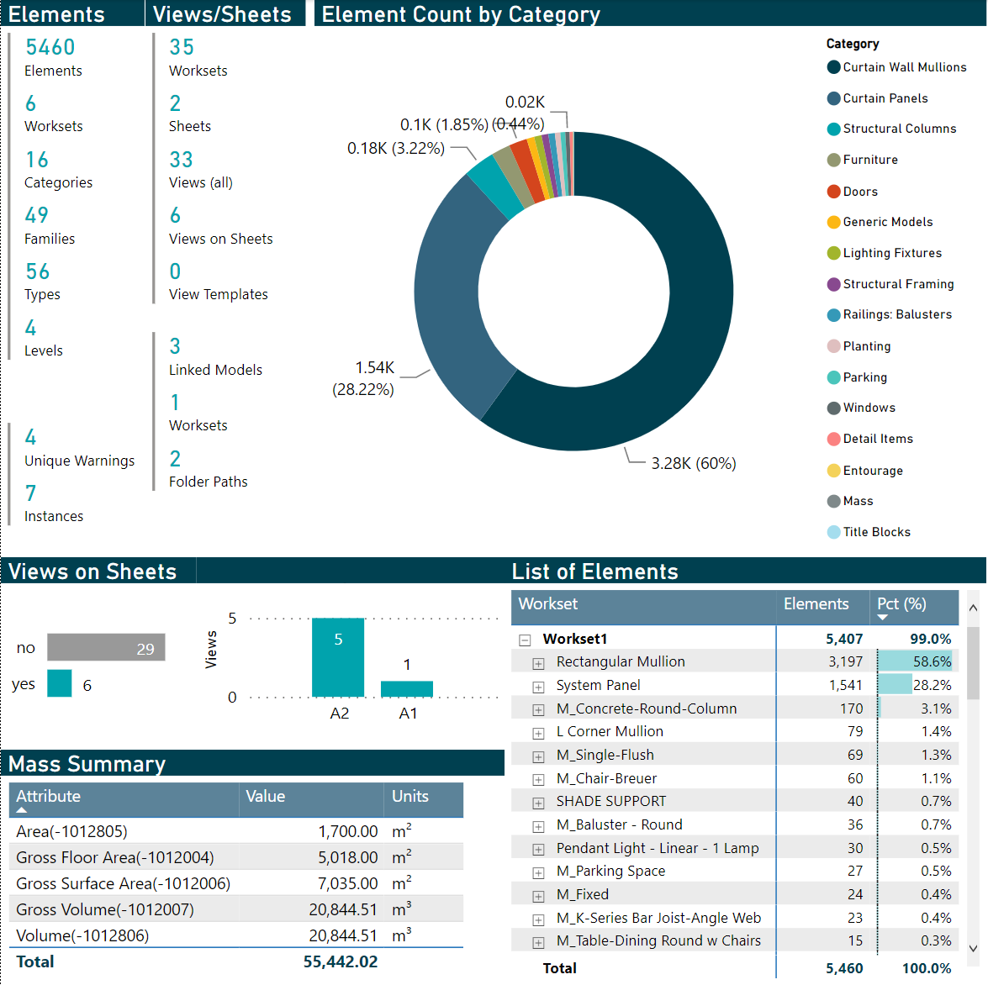
Creating Actionable Revit Model Health Dashboards using Dynamo and Power BI
THE DEVELOPER CHEAT SHEET
June 15, 2022
Sean McDonald, Corporate BIM Manager
Kristopher Dane, Director of Digital Design
James Feracor, Digital Design Technologist
Digital Built Week Americas 2022
Anaheim, California
Notes:
Learning Objective 2
Ability to utilize that system to accept and track changes through a multi-step update
procedure.
Learning Objective 3
Ability to use Dynamo to pass version and change data to a Revit Master file.
Learning Objective 4
Ability to use Dynamo to check the status of details in an active project against a change
tracking system.

Slide 2
Cheat Sheet TOC
A supplemental resource to assist developers with customization
Power BI refresher
Power Query Editors vs Report Editor
Power BI Pro vs Desktop (Free)
Queries
Table Lineage
Data Model
Homework
GitHub Repo
Notes:
Also introduce speakers here

Slide 3


Anatomy of Power bi
Advanced knowledge of Power BI not needed to use template… but it can help you further refine it
What the developers sees (PQ) versus what the end user sees (report editor)
Primary Sections in Power BI
Power Query Editor
Transform and optimize the flow of data that all users to consume
Report Editor
Define the intended user experience, customize the display of information
Intended purpose
‘Process the data so end users don’t have to’
‘Make reports useful and usable’
Subsections
Report View
Create and format visuals
Data View
Available data as a table
Model View
Table relationships
Notes:
Power BI effectively has 4 views, but most are for developers
Power Query Editor
‘If all end users would benefit from a data transformation, it goes here’
Ingest + transform the underlying data sources before visualization
Add/remove columns, combine tables (merge/join, append)
Parameterize file names and manage credentials for source
Create reusable functions
Report Editor, which has 3 sections. Effectively, this is where the user experience is defined in Power BI.
‘In addition to perceived usefulness, reports must also be perceived as usable’
Data Model
Define relationships between tables
This affects how filters/slicers operate on data
Data View
See data available to report as tables
Create calculated tables, columns, and measures
Report Editor
Create and format interactive visualizations
Control usability features (slicers, appearance, interactivity) + aesthetics

Slide 4
Advantages and limitations
Consider the opportunity costs of your deployment
Advantages
Limitations
General Points
Scripts are self-service, on demand (as needed) Small footprint (just save the JSON files)
Engaging interactive reports, rapid turn-around Ability to add company-specific user guidance
Minimal focus on data processing
re
Cannot fully automate execution of Dynamo yet
Single model snapshot only; no comparison features
Power BI Desktop (Free Only)
Automatic, consistent, repeatable data transforms
Source data is unmodified by process
Allow users to export filtered data as needed
Incremental development
No publishing, collaboration features
Does not leverage best features of Sharepoint
Sub-optimal workflow for end users, who must refresh data each time (takes time to re-calculate)
Power BI Pro (or higher)
Web-based platform, centralized sharing
Dataflows + scheduled refreshes
Collaboration: Publishing, Teams integration
Row-based security, incremental refresh
Complex merges cannot be done without Premium level (but there are workarounds!)
JSON files are not centrally managed (no tracking)
ADVANCED TOPICS

Slide 5
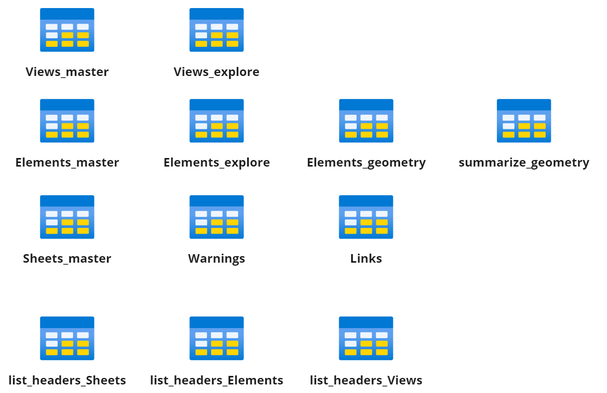
QUERIES
POWER QUERY EDITOR
Query folders are optional, but help you stay organize
Main
Parameters
Primary data tables used to create model + report visuals
Parameters that allow you to swap while JSON files are loaded into the report (from previous slides)
Query Errors
Summary of errors that may have occurred when loading your data
Lookups
Intermediates
Incoming
(Optional) for header tables. Can assist with dev
(Optional) A place to put tables necessary for calculations but not needed for any specific visual. For developers.
(Optional) Folder for new queries while in development or scratch work

Slide 6
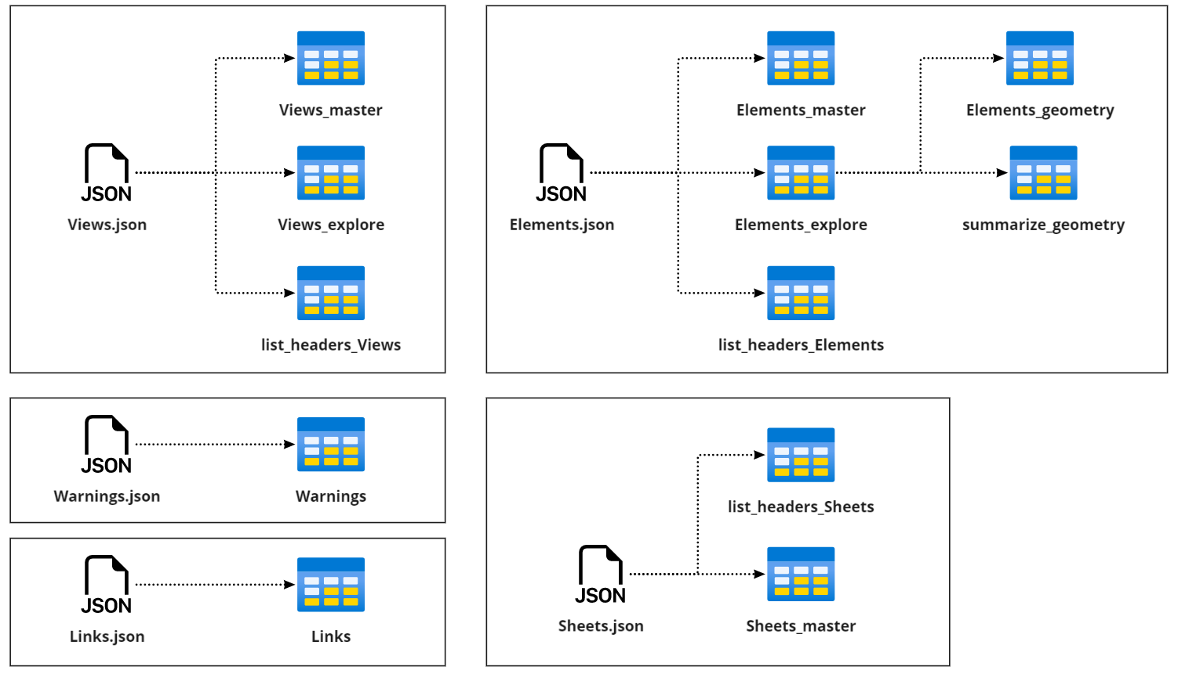
TABLE LINEAGE
POWER QUERY EDITOR
Mapping Table Lineage to JSON Files
Data Cleaning Steps
Split large tables into components
Clean data for formatting
truncate multi-values cells
consistent values
consistent column headers
separate units from quantities
Summarize tables for visuals
Optional (but helpful)
Generate lists of column headers to assist with development
Notes:
Each JSON file is used to create 1 or more tables:

Slide 7
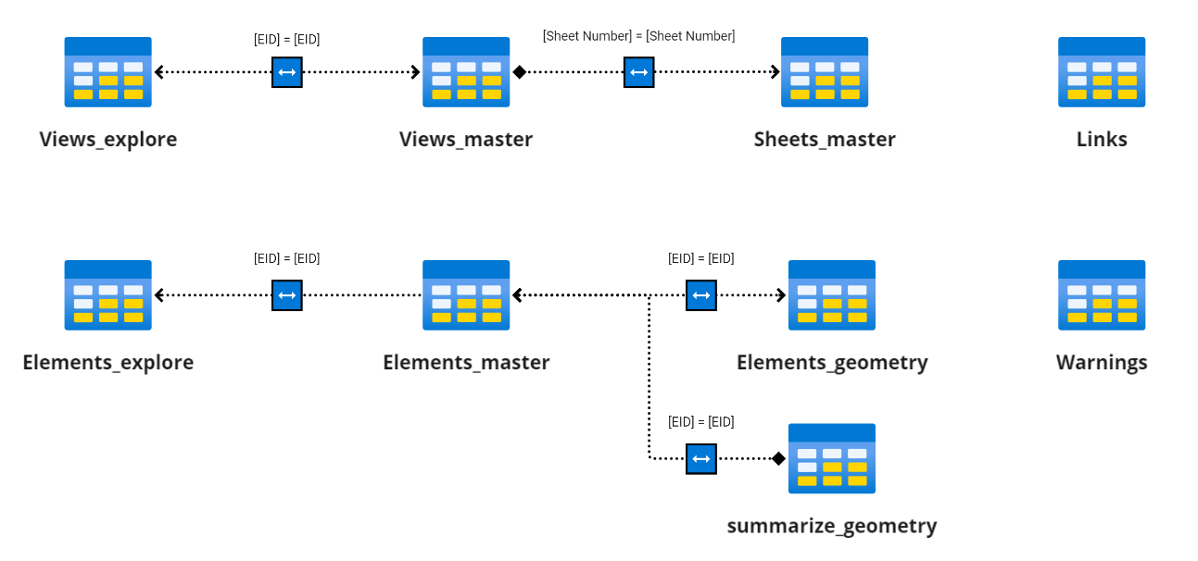
Data MODEL
REPORT EDITOR
For developers who want to expand on the template model
Data Model as it exists in the Power BI template
Note that Links and Warnings tables are not connected to the model
Future development could link elements to views and sheets they belong to
New tables based on Elements or Views should be related to their corresponding ‘master’ table
When creating slicers for views or elements, use the ‘master’ table columns
This ensures slicers are synced across pages

Slide 8

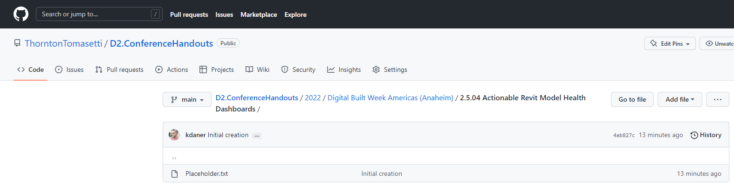
homework
Getting started on your own
Download file from GitHub Repo (see QR code)
Power BI Template
Dynamo Scripts
Additional Resources for Devs
Do the Preparation Checklist
Run Dynamo on a model
Save JSON files in a folder
Configure Template
Update parameters to JSON files + path
Refresh Data!
Optional Next Steps
Customize Template
Develop Roadmap
GitHub Repo

Slide 9
What’s in the GitHub Repo?
Table of Contents
Power BI reports (where Power BI template is stored)
Power BI Data
Where you should put your JSON files
Includes a sample set to help you start
Sample Models (Revit model used in demo)
Dynamo Scripts (Dynamo scripts to be run on Revit models)
Resources
Handouts and notes
This slide deck

Slide 10
Thank you
Contact info
ThorntonTomasetti.com

Slide 11
EXAMPLES

Slide 12
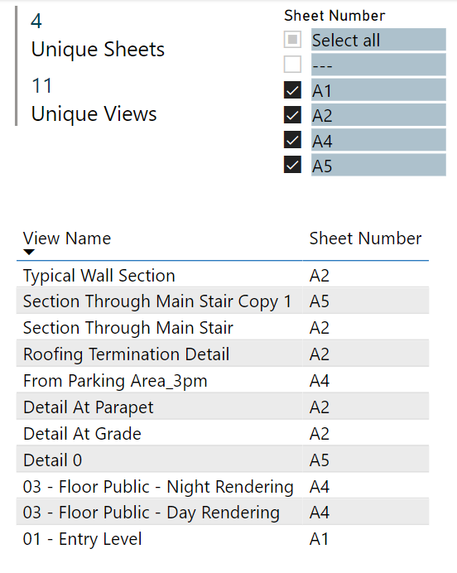
Example Customization #3
ADVANCED TOPIC
Add a new measures and calculated columns
Query: How many views appear in sheets?
Solution: 3 different ways of getting this, but different use cases!
Option 1: ‘Lazy* Solution’
1. Use Views_master table
2. Count distinct sheet numbers and view names
3. Use filter to remove “---” from results. Done!
Why is this ‘lazy’?
For this calc to work, we manually set the filter to remove “---”
What if the user wants to see all the views but also see the number of Views on Sheets? Too bad.
What if we just want a single button to quickly filter to views on a sheet (all of them)? Also, too bad.

Slide 13
Example Customization #3
ADVANCED TOPIC
Add a new measures and calculated columns
Query: How many views appear in sheets?
Solution: 3 different ways of getting this, but different use cases!
IsViewOnSheet = IF( Views_master[Sheet Number] <> "---", "Yes", "No“ )
Option 2: Column Calc + Measure
Create a calculated column in View_master that indicates Yes/No if a view is on a sheet
Create a measure in View_master that counts rows where [Category] = “Views” and [Sheet Number] is NOT “---”
num_views_on_sheets = CALCULATE(
COUNTROWS(Views_master),
FILTER(ALL(Views_master),
Views_master[Category] = "Views" &&
Views_master[Sheet Number] <> "---"
)
)
Do we need both?
Yes, if you want to calculate the total views on sheets REGARDLESS of what filters are selected.
For example, if you filter out Sheet A2, you may want to know the SELECTED number of sheets on views versus the TOTAL number of sheets on views.

Slide 14
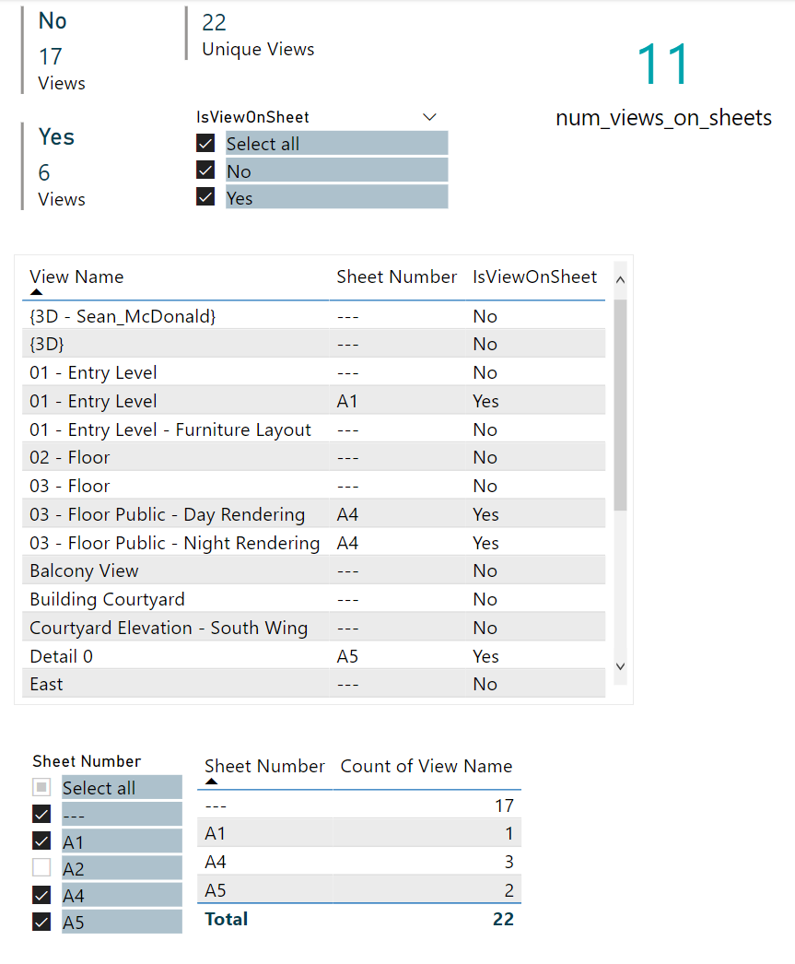
Example Customization #3
ADVANCED TOPIC
YES/NO Column allows us to select ALL views on sheets (rather than individually)
Add a new measures and calculated columns
Query: How many views appear in sheets?
Solution: 3 different ways of getting this, but different use cases!
Option 2: Column Calc + Measure
Create a calculated column in View_master that indicates Yes/No if a view is on a sheet
Create a measure in View_master that counts rows where [Category] = “Views” and [Sheet Number] is NOT “---”
Are there other ways?
Yep! Can create a calculated column in Sheets_master to find the total number of views per sheet (rather than Views_master) table, then add these numbers.
Advantageous b/c it gives you the views PER sheet as a filterable column, rather than a dynamic calculation (which cannot be used as a slicer).
When A2 is filtered out, only 6/11 views on sheets remain

